Slide 1
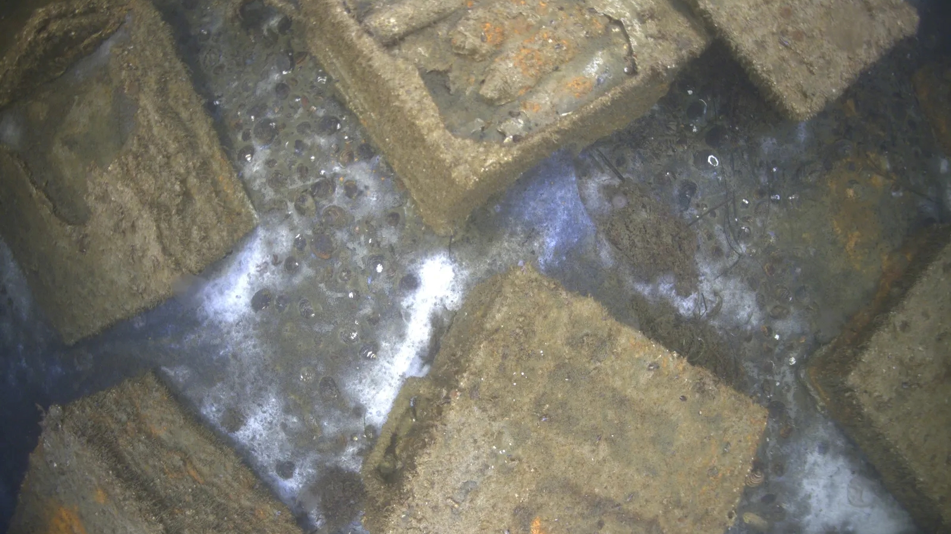

The Evolution of Underwater Explosive Ordnance Detection: Next-Generation Approaches
Cavtat, Croatia 2025

Slide 2


The Explosive Ordnance Knowledge Hub (EOK HUB) serves as a central point for exchanging knowledge and experience in the explosive ordnance sector. It is an independent and transparent platform where you can access information on a range of topics, from machines to policy, dogs to unmanned aerial systems.
EOKHUB Digital Magazine, launched in 2025, emerges as a bi-monthly publication that connects explosive ordnance experts, security professionals, and technology innovators worldwide through compelling narratives, technical content, and industry insights.

Slide 3
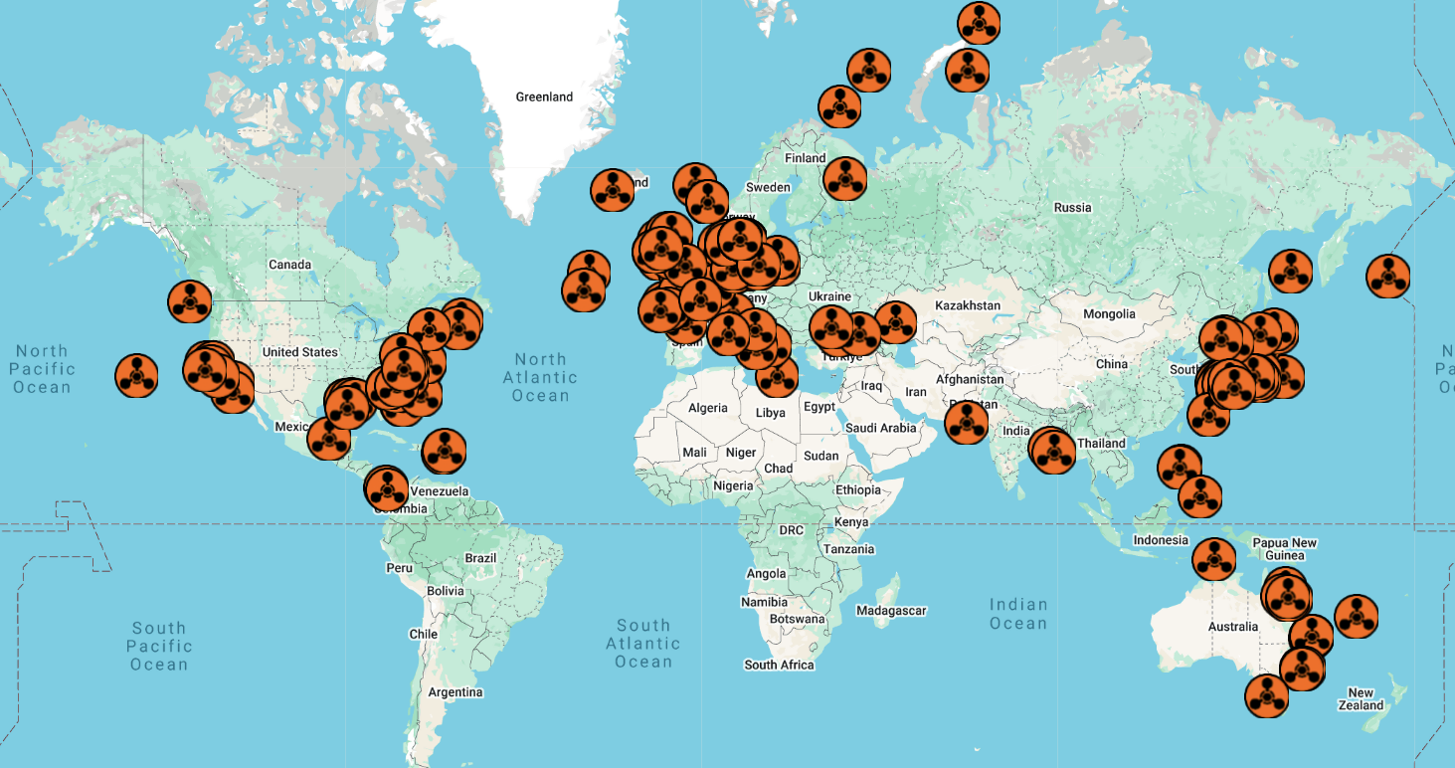

Slide 4
Acoustic Frequency
Areas with Potential Interference with the Measurements
Beam Opening Angle
Clearance Depth
Current Speed
Draft
Interpolation Distance
Investigation Radius
Magnetic Moment
Measurement Distance
Number of Sensors
Pings per Area
Positioning Uncertainty
Range
Reference Object
Sample rate
Sensitivity
Signal Noise
Significant Wave Height
Slope distance to the Survey Vessel
Spatial Resolution
Speed Over Ground
Survey Gaps
Survey Line Direction
Survey Line Length
Time Windows
Total Field Amplitude
UXO Depth Zone
Visual Range Above Water
Water Depth
Wind Speed

Slide 5
A Historical Perspective: The Foundations of Underwater EO Detection
Early Detection Techniques (1945-1990)
The Modern Era: Advanced Detection Systems (1990-today)
Next-Generation Technologies: The Future of Underwater EO Detection

Slide 6
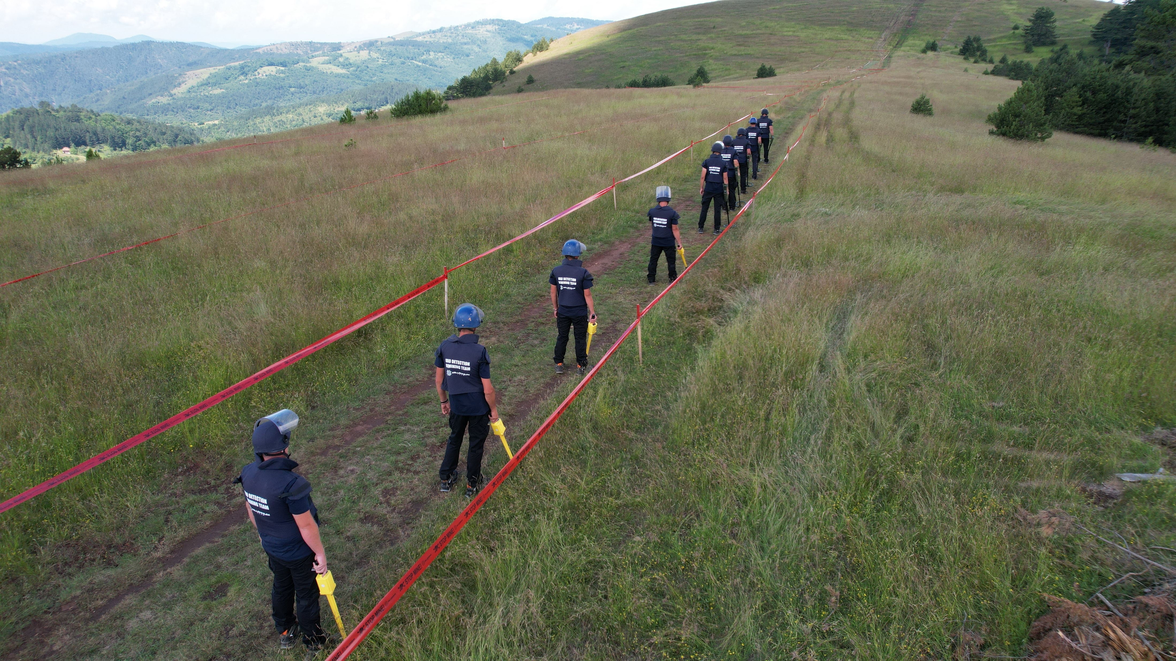
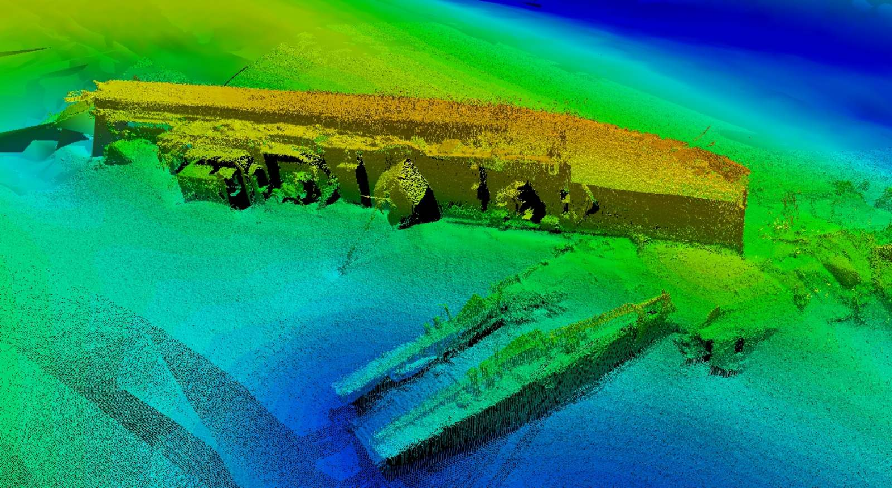
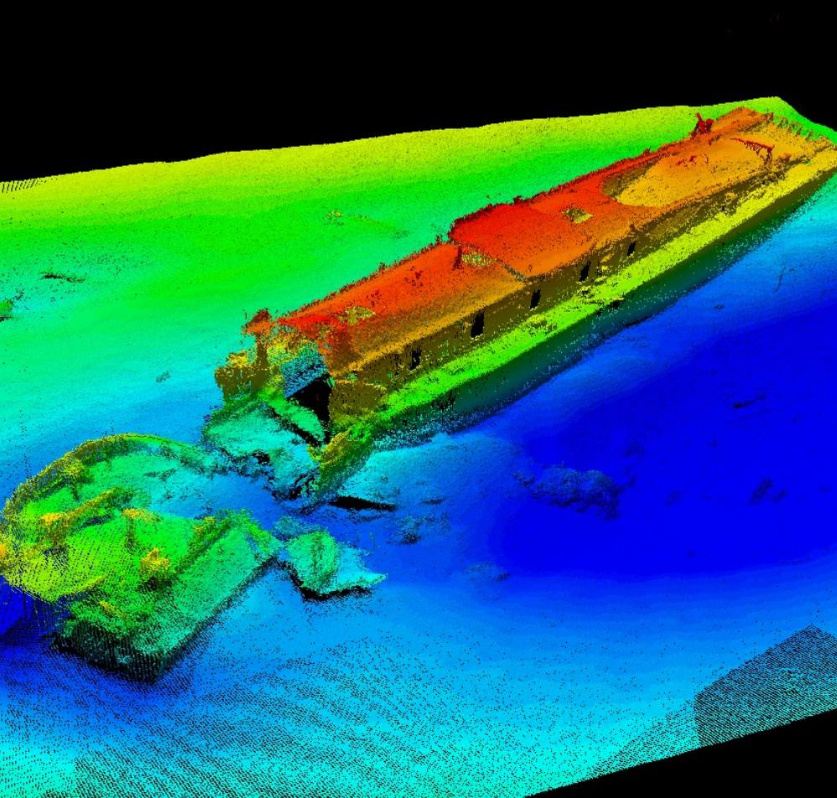
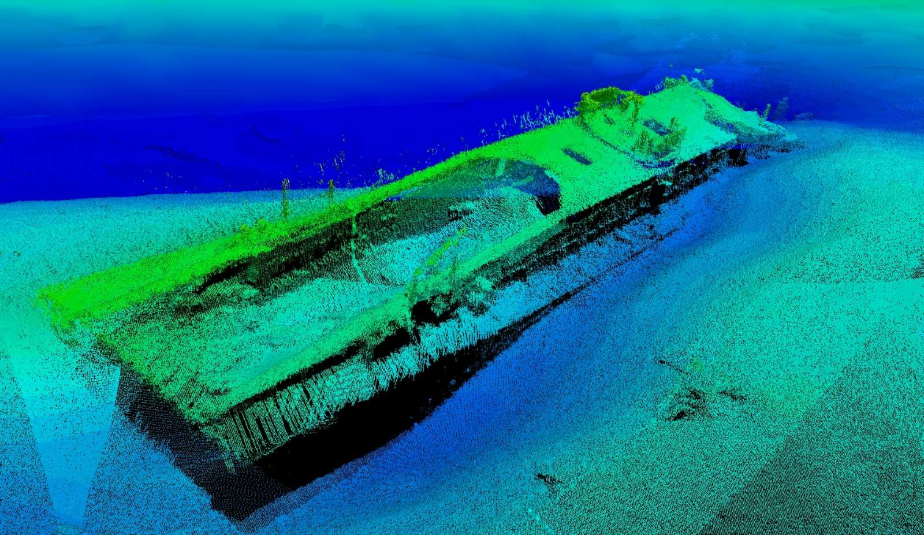
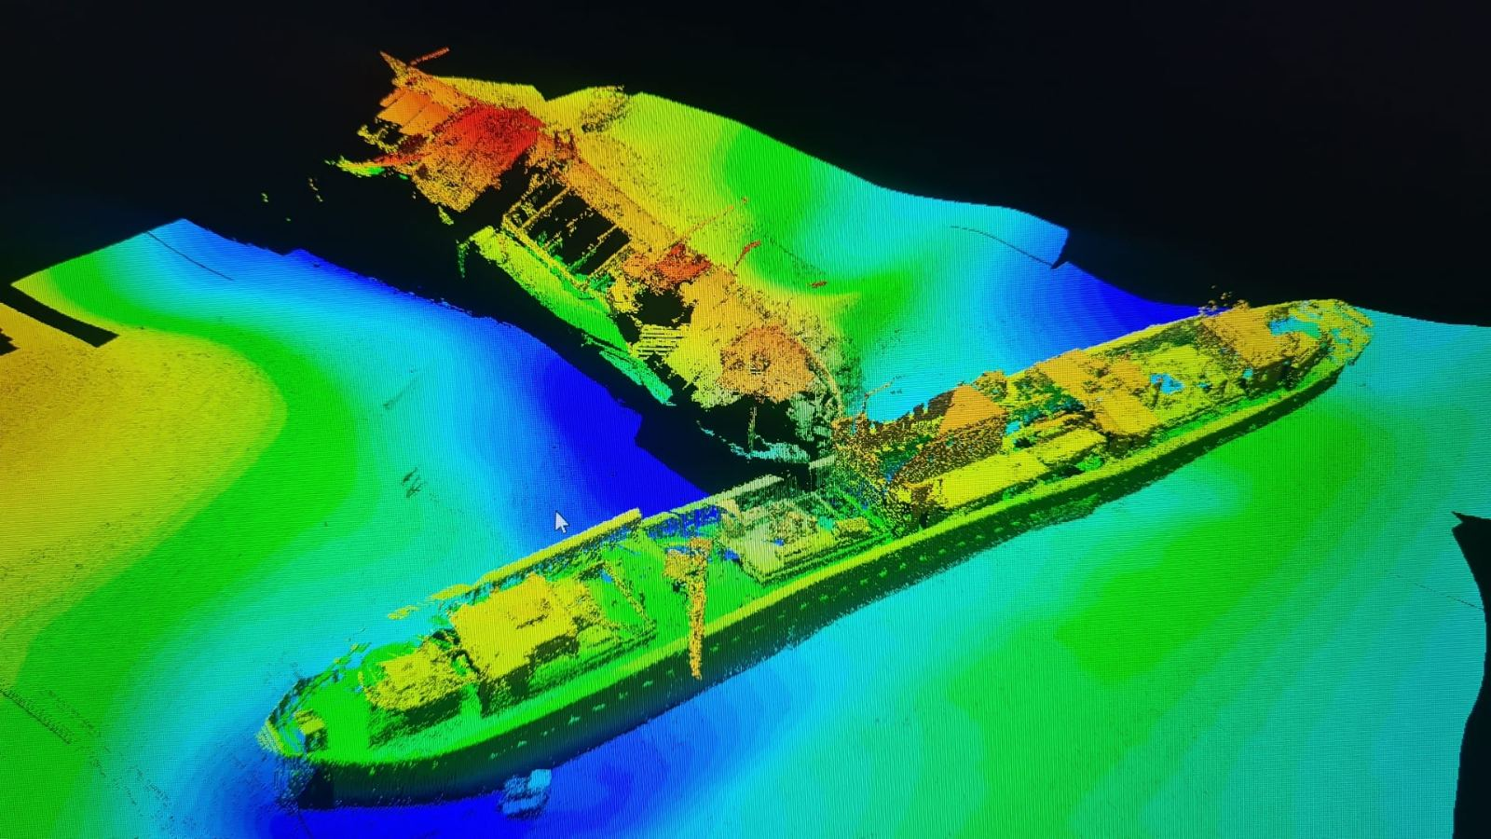
3D VISUALIZATION OF THE WW II GERMAN SUNKEN VESSELS FROM SPECIALIZED SOFTWARE - HYDROGRAPHIC SURVEY
Credit: Millennium team

Slide 7
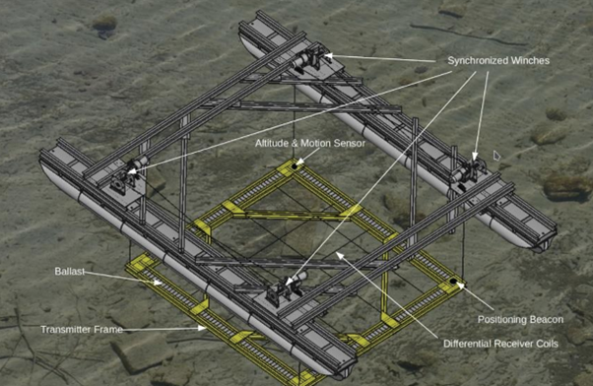
Underwater Time-domain Frequency Electromagnetic (TFEM)
Technical specifications
Length: 8.60 meters
Width: 6.20 meters
Draft of Pontoons 0.40 meters
Water Depths for Operation: 3.0 to 25.0 meters
Water Depth Control: Echo sounder on the ship
Height Adjustment to Topography: Automatic winch control linked with echo sounder
Surface Positioning: BX982 GNSS Positioning and Heading System (RTK)
Underwater Positioning: USBL (Ultra-Short Baseline), DVL (Doppler Velocity Log)
Transmitter Power: 4 to 40 Amps
Sampling Rate: 10 Hz to 100 Hz
Data Recording: Onboard using AGS Track software
Resolution: 32-bit, up to 1 MHz
Measurement Line Spacing: 4.0 meters
Measurement Field Map: DXF overlay

Slide 8
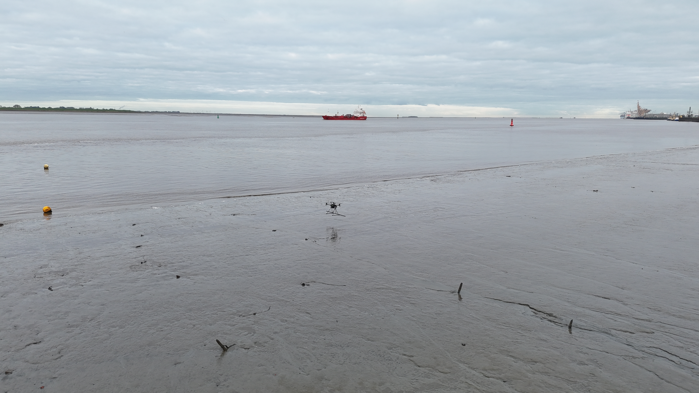
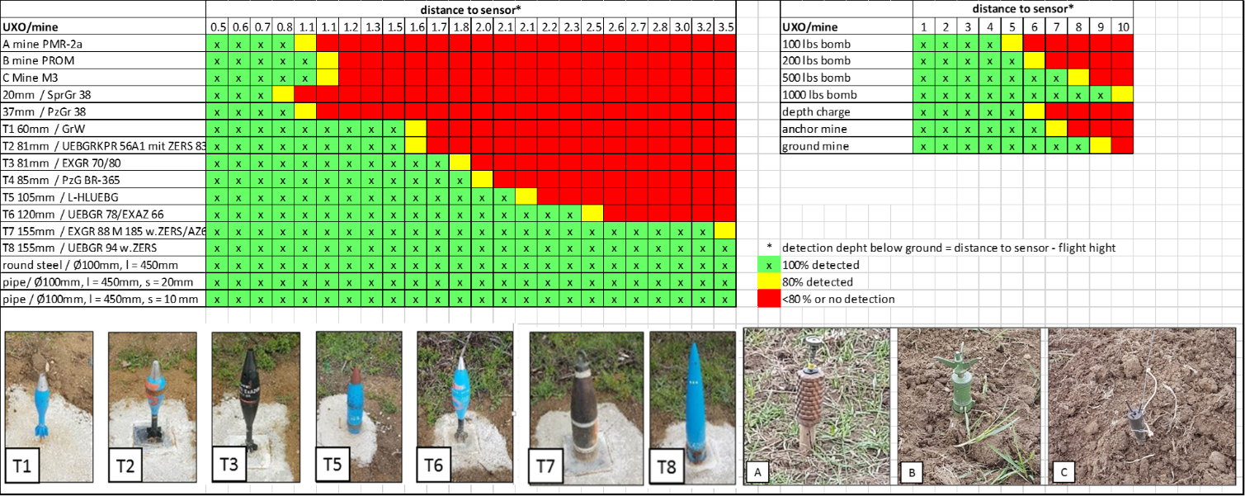
A2dvance Near-surface Detection System

Slide 9
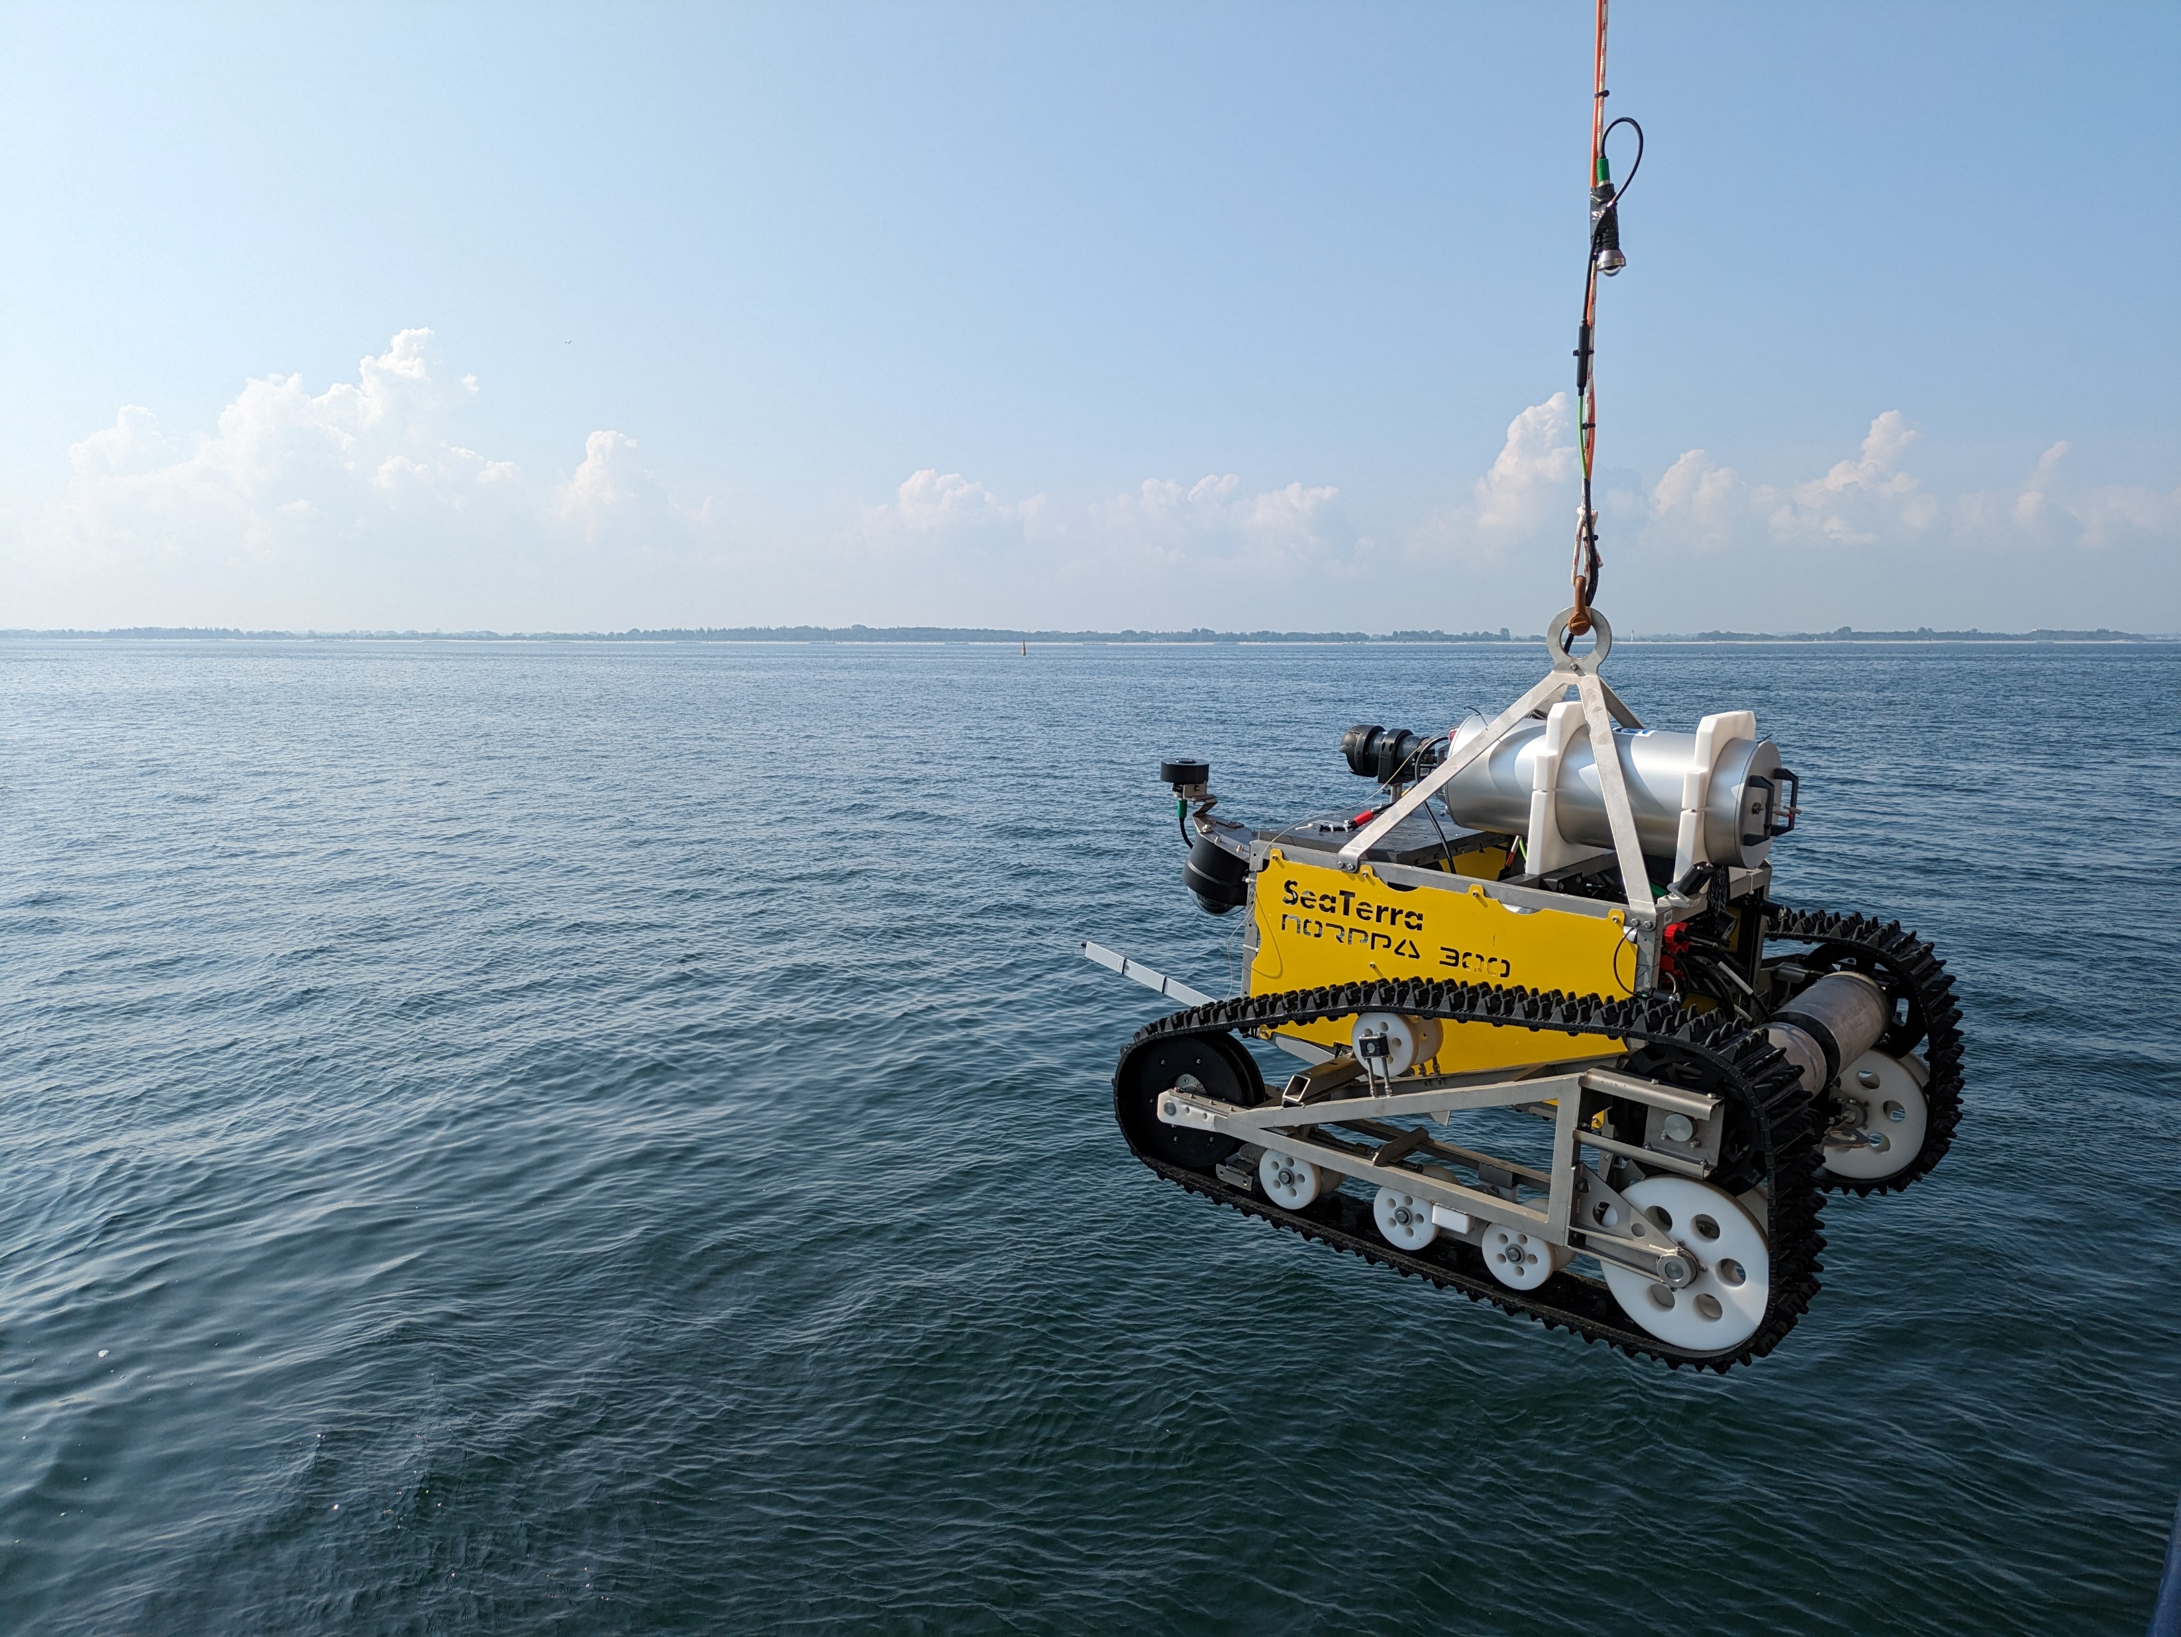
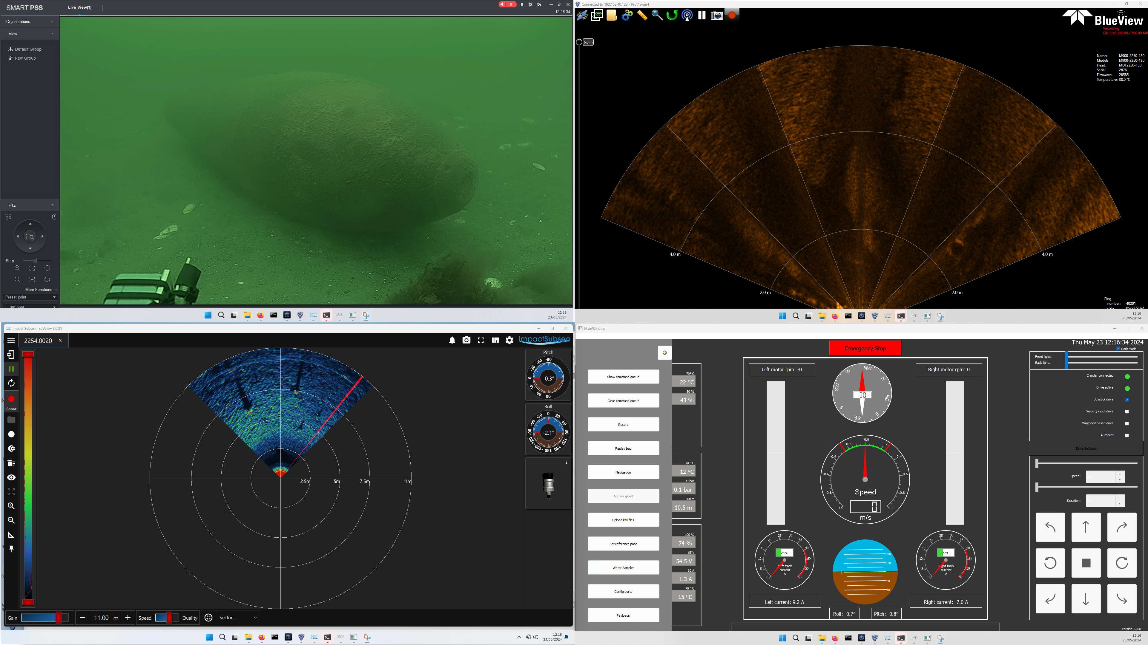
UXO Crawler
Notes:
Aris

Slide 10
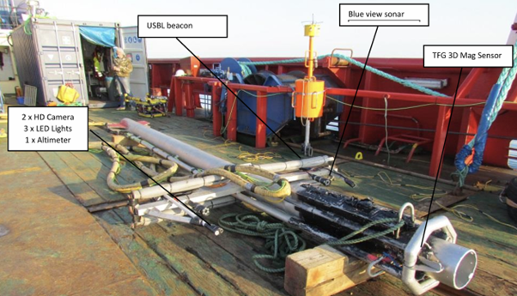
Remotely operated air-lift (ROAL)

Slide 11


Slide 12
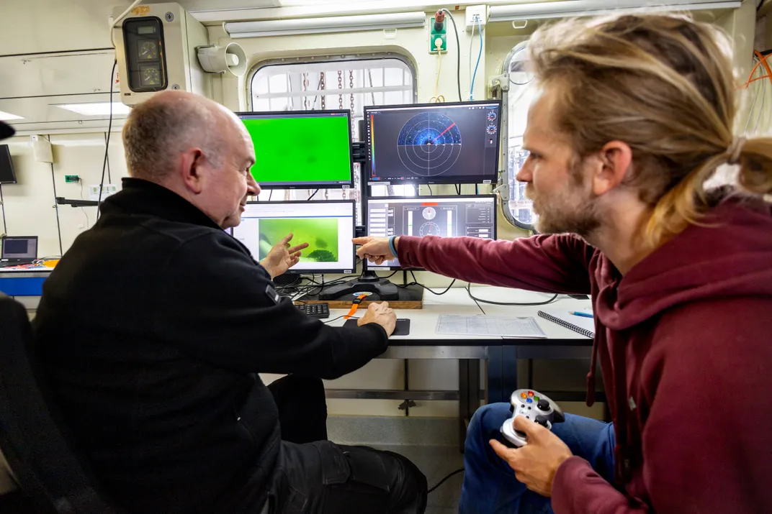
Challenges
Complex marriage between technological advancement and operational expertise
Focus on diverse environments: rivers, lakes, shallow waters, transition areas, swamps
Systems must enhance, not replace, human judgment
Contrast between large-scale operations and SMEs
Balance between capital investment and operational costs
Training and certification requirements
Credit: SeaTerra GmbH

Slide 13


Main Strategic Focus:
Transition from Service-Only to Engineering-Focused UXO Maritime Operations
Key Development Areas:
Sustainable Capability Development
Technology Integration
Safety & Effectiveness
Commercial Development

Slide 14



