Slide 1




FROM THREAT DETECTION TO NEUTRALIZATION: AIDEDex, CONVOY and GENIUS
EDF-2022-LS-RA-CHALLENGE-DIGIT-HTDP
EDF-2023-RA-PROTMOB-DEXPLO
Mine Action 2025 - 03/04/2025
These projects have received funding from the European Defence Fund.. Views and opinions expressed in this presentation are however those of the authors only and do not necessarily reflect those of the European Union or the Commission. Neither the European Union nor the granting authority can be held responsible for them.
© GMV Property – 20/04/2024 - All rights reserved

Slide 2
AGENDA
01
04
TECHNOLOGICAL CHALLENGE
GENIUS
02
AIDEDEX
03
CONVOY

Slide 3
01. TECHNOLOGICAL CHALLENGE

Slide 4

TECHNOLOGICAL CHALLENGE
  DG DEFIS launched the first European Defence Fund (EDF) Technological Challenge, addressing technologies for the detection of improvised explosive devices (IED) and landmines.
ORGANIZER
HiTDOC
Organize a challenge, based on the design and development of test procedures and methodologies, that will allow evaluating the performances of detection technologies. During the iteration of four challenges, the testing procedures will be further updated, aiming at being able to propose, at the end of the project, recommendations on standardized test procedures to objectively evaluate system performances
PARTICIPANTS
AIDEDEX
CONVOY
DETERMINE
TICHE
© GMV Property – 20/04/2024 - All rights reserved

Slide 5






FIELD CAMPAIGNS
Campaign Evaluation Plan
CAMPAIGN #1
(SWEDEN)
Initial assessment (Dry run)
Areas for improvement (possible gaps)
Data acquisition and training
CAMPAIGN #2
(SWEDEN)
Improvements compared to the previous campaign
Validation
Data acquisition and training
CAMPAIGN #3
(SWEDEN)
Improvements compared to the previous campaign
Validation
Data acquisition and training
CAMPAIGN #4
(SPAIN)
Improvements compared to the previous campaign
Validation
FINAL RESULTS
RURAL ENVIRONMENT
RURAL ENVIRONMENT
URBAN ENVIRONMENT
URBAN/RURAL
© GMV Property – 20/04/2024 - All rights reserved
Notes:
Incremental process to collect data, validate algorithms, and improve the system iteratively

Slide 6
02. AIDEDEX

Slide 7
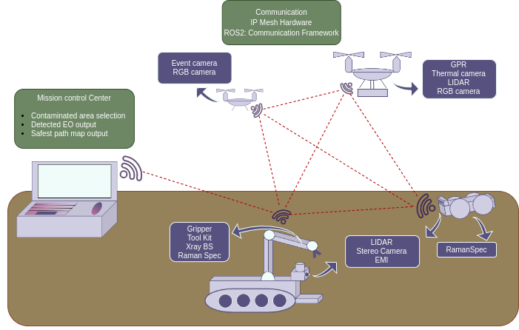
CONCEPT
Cooperate to quickly map the environment and provide an accurate location of the detected IEDs.
Identify and Classify unconventional (IEDs) and conventional (Buried Mines) threats
Autonomously plan offline and run-time missions for multiple-agents/robots
Provide positioning, navigation and mapping to control a fleet of unmanned vehicles
Limited Manipulation of the target for closer inspection
Collection of broader information as inputs to the intelligence system
© GMV Property – 20/04/2024 - All rights reserved
Notes:
Incremental process to collect data, validate algorithms, and improve the system iteratively

Slide 8
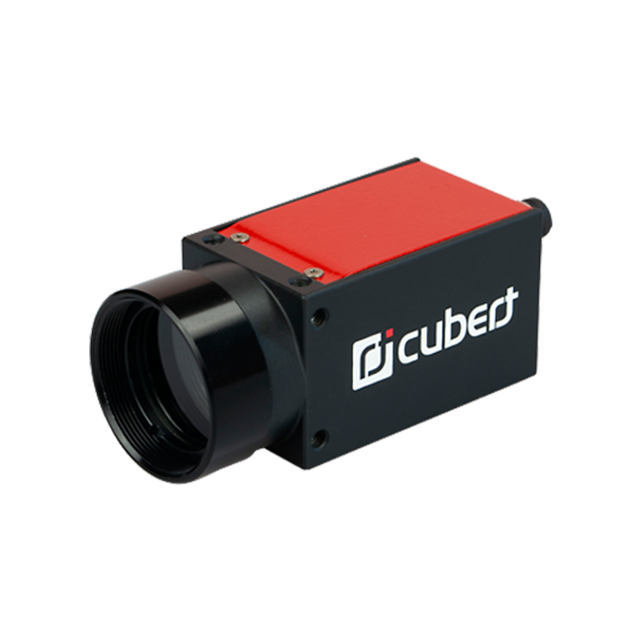
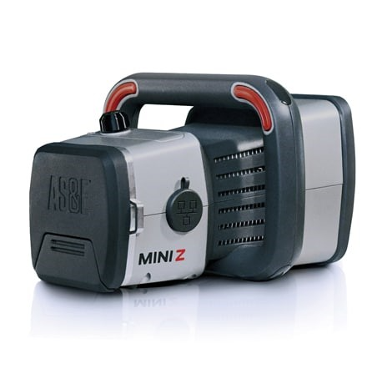
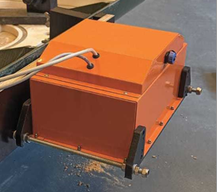
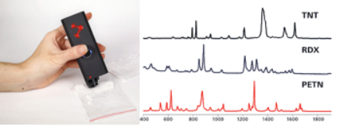
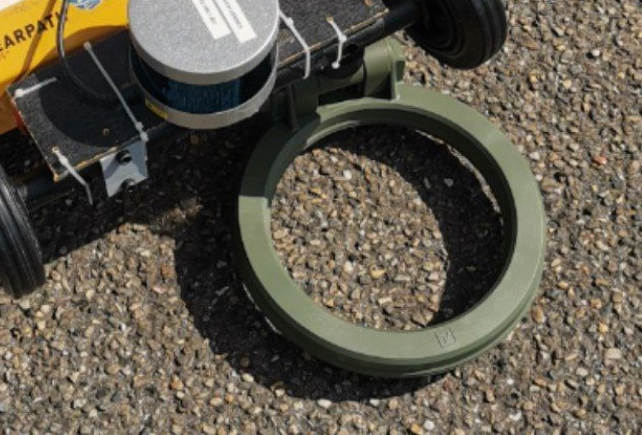
SENSORS, DATA PROCESSING, MISSION PLANNING
Classical, Model based & AI solutions for EO detection and Classification
  Electromagnetic Induction array
  Thermal/Hyperspectral camera
  Ground Penetrating Radar
  X-Ray Backscatter
  Raman Spectrometer
AI based multi-agent Mission Planning
Classical and ML solutions for multi-agent Perception and Navigation.
Representative Demonstration with Heterogeneous Swarm
Real world equivalent of IEDs, Landmines , Explosives and Materials
© GMV Property – 20/04/2024 - All rights reserved
Notes:
Incremental process to collect data, validate algorithms, and improve the system iteratively

Slide 9
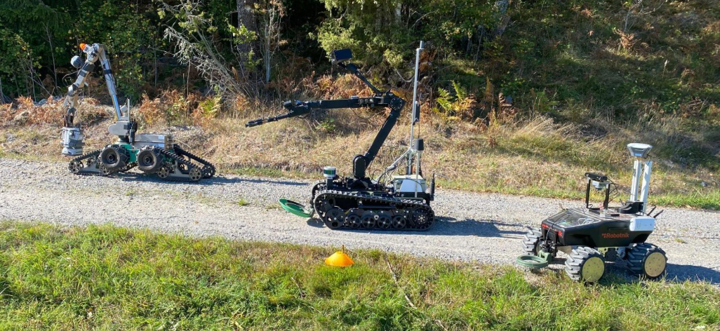
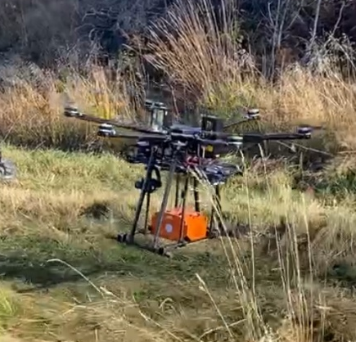
Results
CAMPAIGN #1 (SWEDEN)
Independent 4xsystems equipped with sensors for detection and navigation
Data collection, annotation, localization of threats
Limited runt time data processing for detection – mostly offline
Generation of first round of results for detailed analysis and metrics
© GMV Property – 20/04/2024 - All rights reserved
Notes:
Incremental process to collect data, validate algorithms, and improve the system iteratively

Slide 10
03. CONVOY

Slide 11

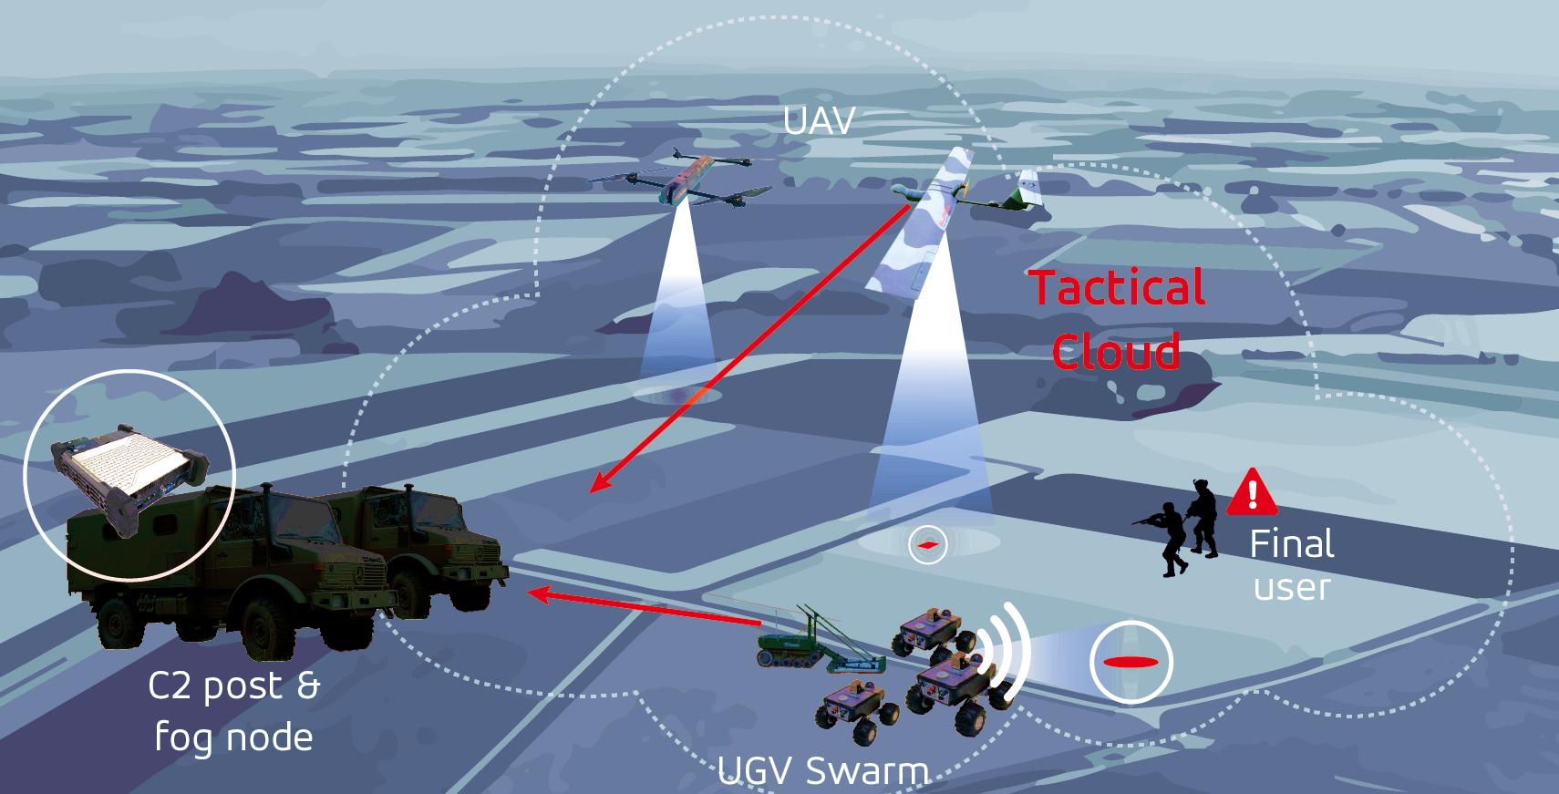
OVERALL CONCEPT
© GMV Property – 20/04/2024 - All rights reserved

Slide 12

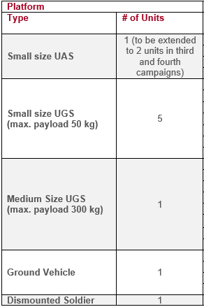
SYSTEM COMPONENTS
© GMV Property – 20/04/2024 - All rights reserved

Slide 13

INFORMATION WORKFLOW
1st Threat Assessment (sweep): the edge computing sensors processing and fusing the data to provide a first level threat evaluation (candidate threat). This is to cover wide areas. Individually done by each sensor. This first stage shall be optimistic (high probability of detection). The result of such assessment and the sensor data are shared on the tactical cloud.
2nd Threat Assessment (classify): the candidate threats are investigated in a second level of processing and fusion leveraging on auxiliary data such as cartography. These potential threats are then investigated by using additional (penetrating) sensors to be confirmed or refuted.
© GMV Property – 20/04/2024 - All rights reserved

Slide 14

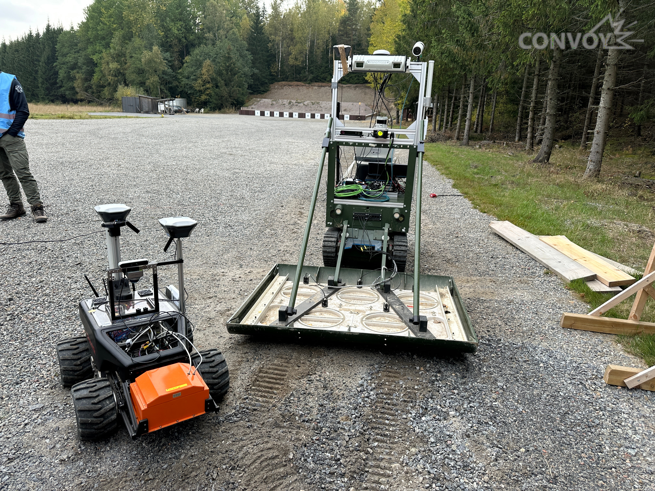
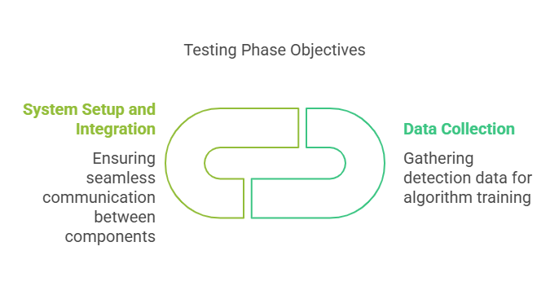
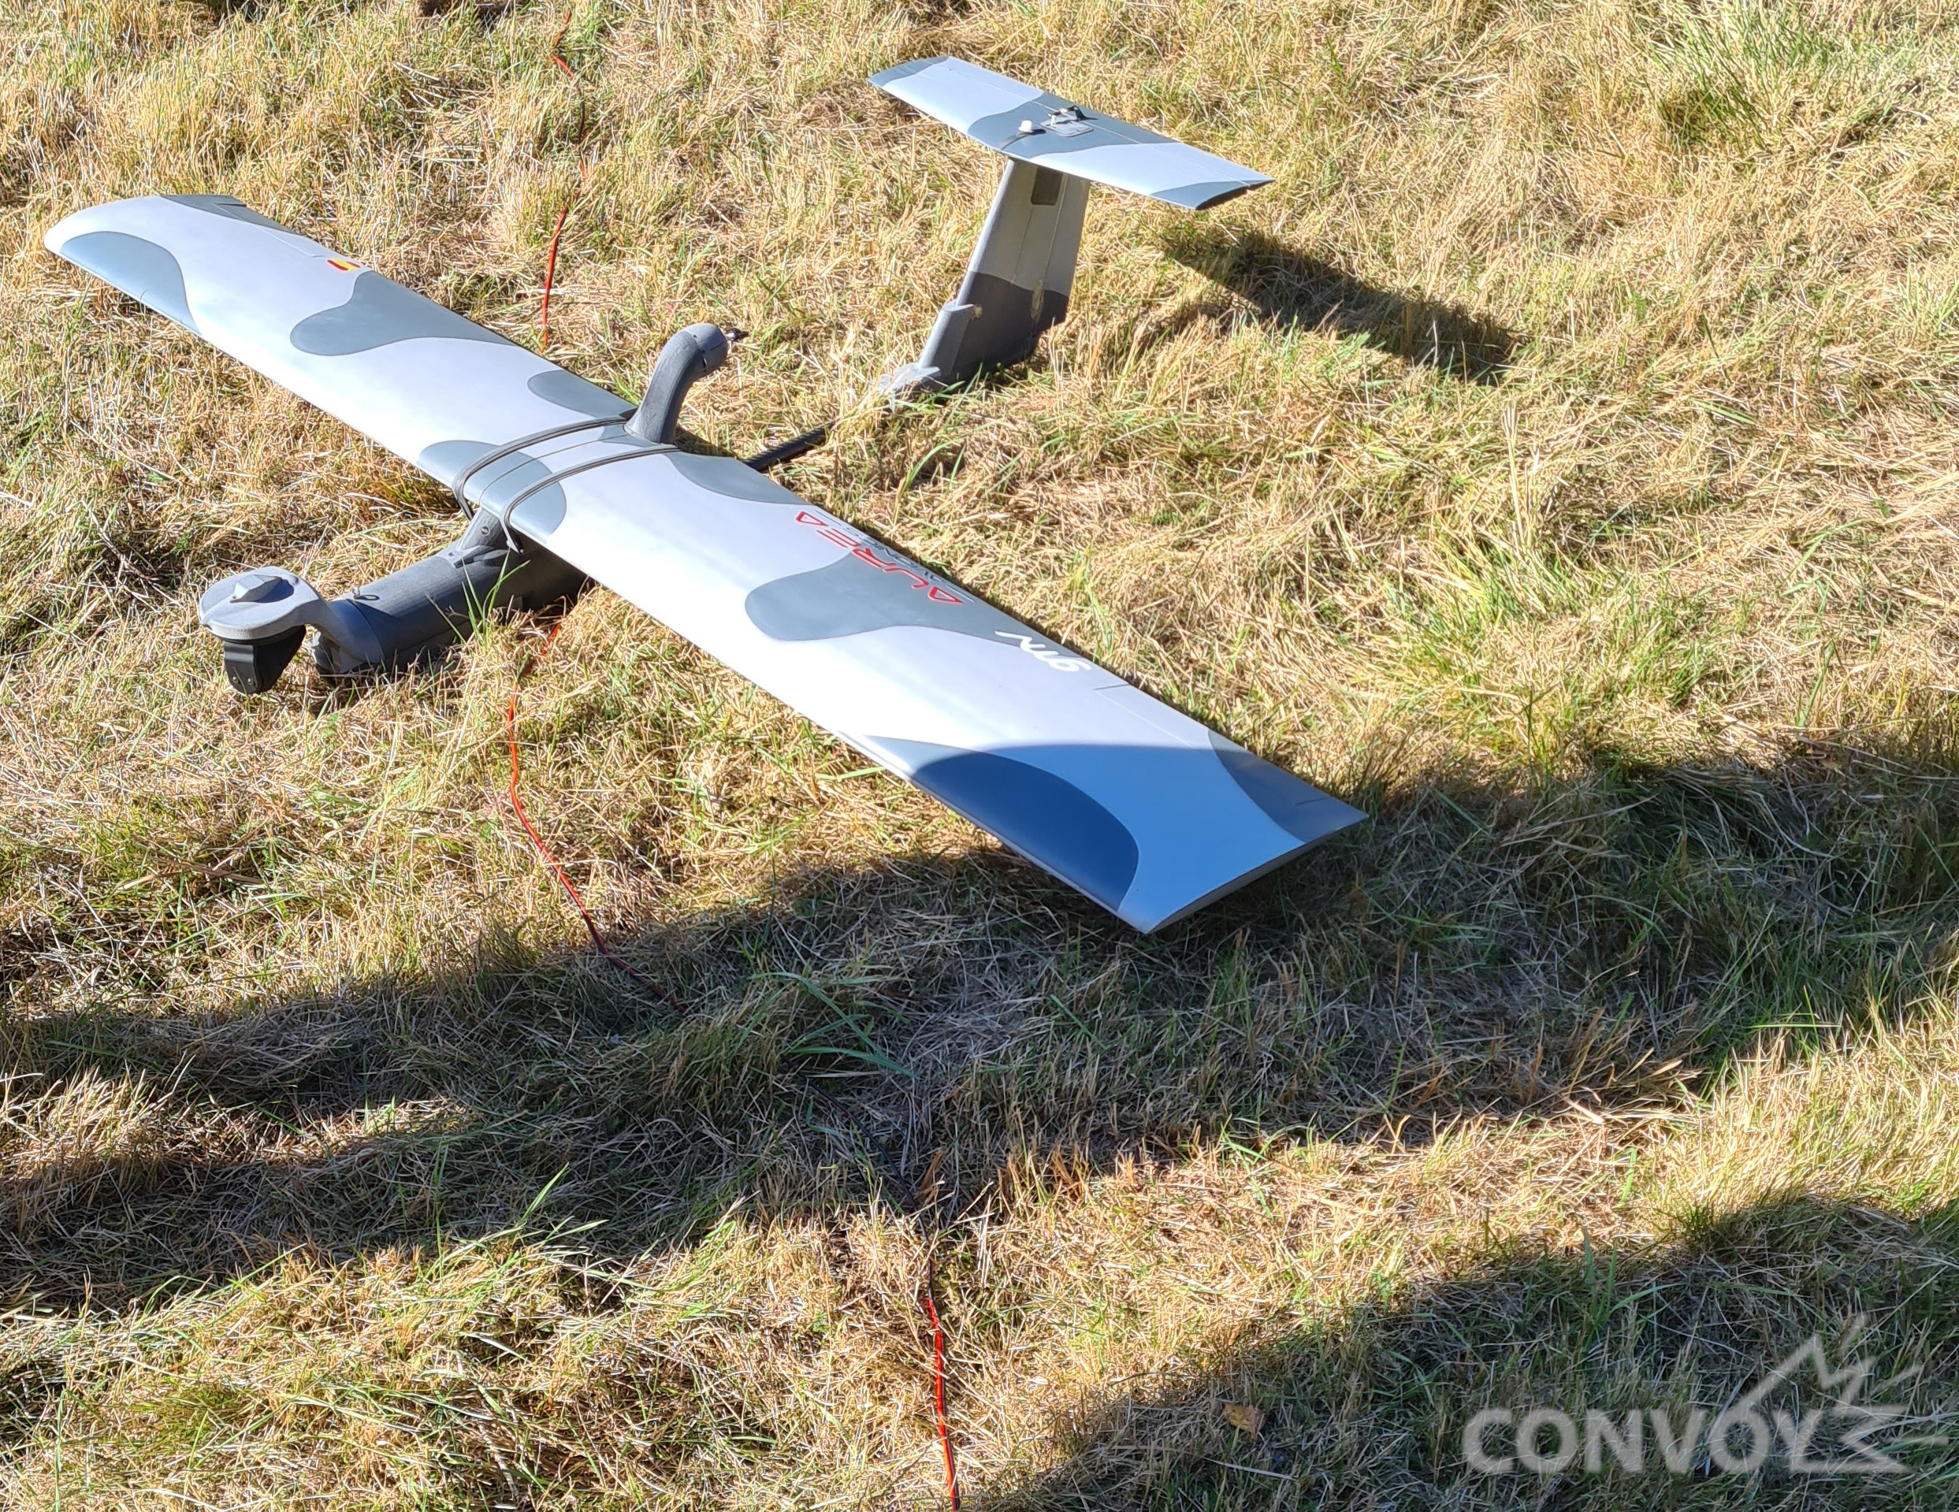
RESULTS
CAMPAIGN #1 (SWEDEN)
© GMV Property – 20/04/2024 - All rights reserved

Slide 15
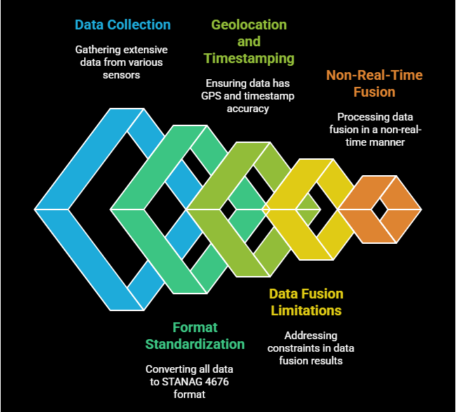
LESSONS LEARNED
© GMV Property – 20/04/2024 - All rights reserved

Slide 16
04. GENIUS

Slide 17

PROJECT DESCRIPTION
  GENIUS aims to improve improvised explosive device (IED) and unexploded explosive ordinance (UXO) mine counter technologies to deal with new and evolving threats
  CALL TITLE: Research actions on force protection and mobility
  DURATION OF THE PROJECT: 36 months
  Defeating unexploded explosive ordnances and IEDs
The project will study and design solutions to increase the accuracy of UXO/IED explosive detections. The inclusion of new technologies, sensors for detection, set of effectors, including a UGV for neutralisation and handling, will significantly improve IED and UXO mine counter technologies to deal with new and evolving threats.
This will reinforce EU armed forces capabilities in countering UXO/IED threats and increase the independence and competitiveness of the EU defence market.
17

Slide 18

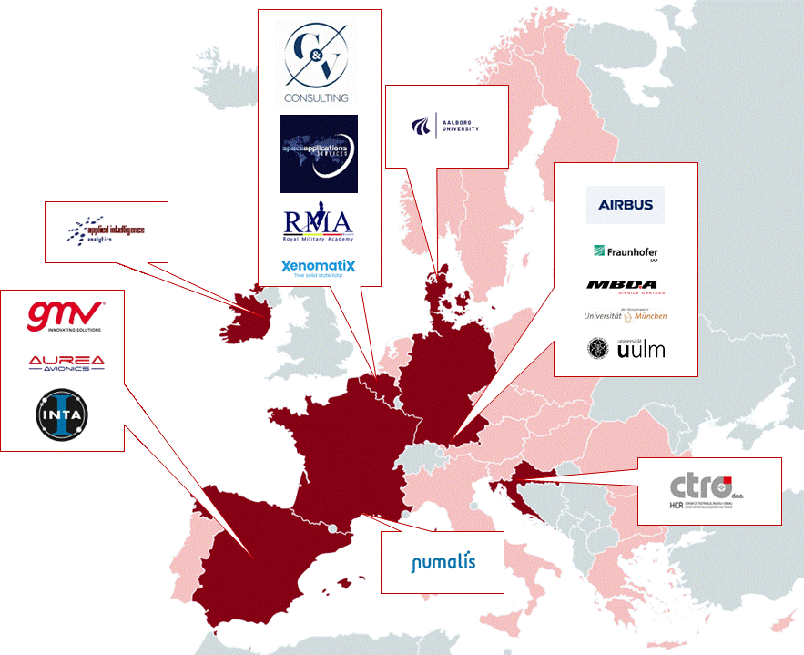


















TEAM MEMBERS
Member States
18 beneficiaries
Coordinator
Notes:
Partners:
Large Ind: Midcap: Military Research Org. Academic inst.: RTO: SMEs: Small and medium size companies

Slide 19

OBJECTIVES AND BACKGROUND
1 consortium
(18 partners)
Use of ground and aerial borne sensors combined with information fusion techniques
Significantly improve the accuracy of detections
Enhance threat classification with the support of AI
Neutralization and disposal of threats with different systems, including disposable UxVs for decoying threats
Development of an advanced sensor data management and visualization tool
Development of cloud-connected unmanned vehicles leveraging AI to adapt to different scenarios and conditions
3 years
3. Neutralization
1. Detection
2. Classification
1 evaluation campaign (field test)

Slide 20
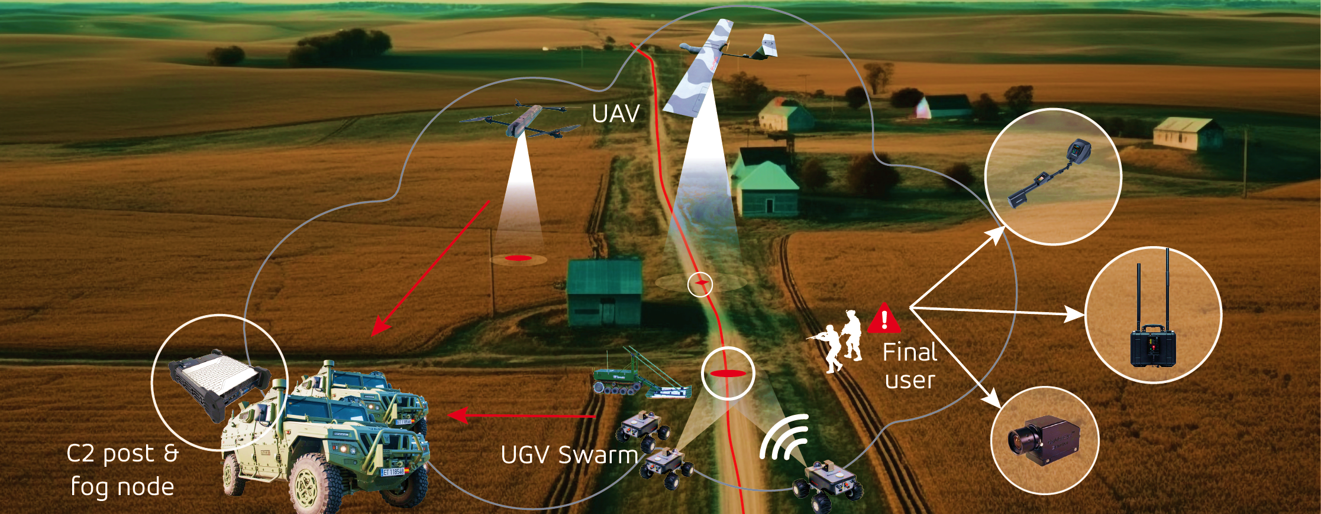
OVERALL CONCEPT
Multi-platform approach.
Reconnaissance of the area to detect possible threats.
Multi-sensor approach.
Multi-effector approach.
Command Post to control UxVs.
Information gathering.
Deployment of a Fog Node (cloud infrastructure).

Slide 21


gmv.com
https://www.convoy-eu.com/
Thank you
Carolina Bustillo Morán
Technical Expert
cmbm@gmv.com
+34 918072100
Vicente de Ayala Parets
Technical Manager
vjdayala@gmv.com
+34 918072100
Shashank Govindaraj
Division Manager
sgo@spaceapplications.com
+32 24160587
© GMV Property – 20/04/2024 - All rights reserved

