Slide 1

ARTIFICIAL INTELLIGENCE FOR MINE ACTION
Croatia Mine Action Symposium 2025
03 APR 2025

Slide 2
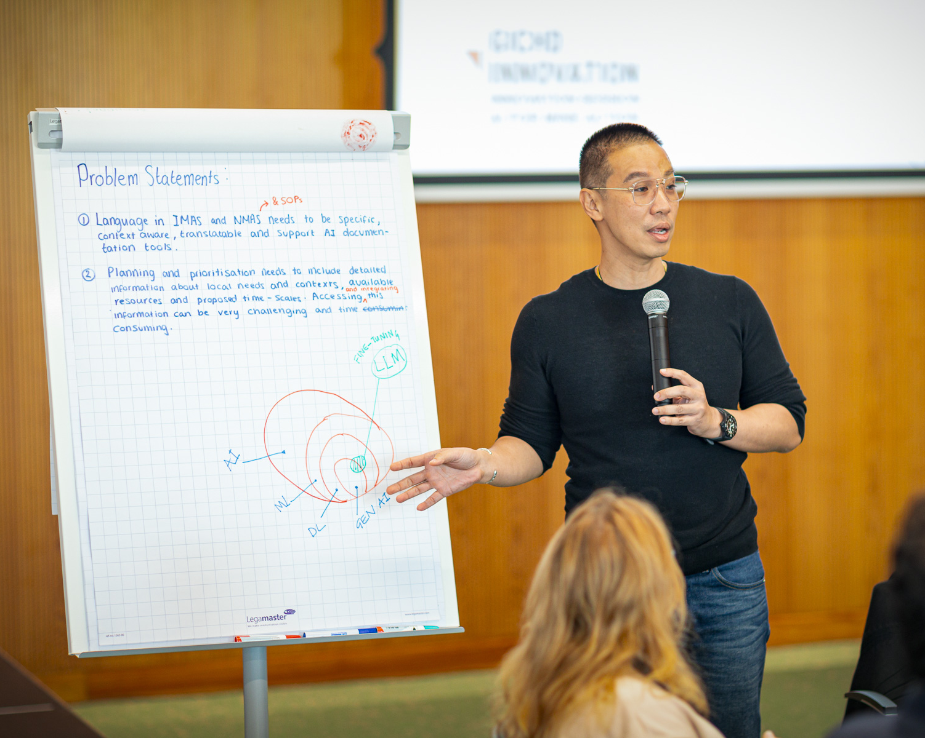
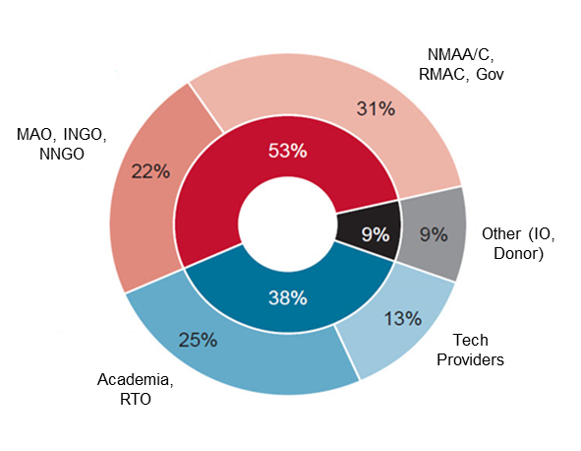
INNOVATION SESSION: THE Approach
Cross education between Mine Action practitioner and AI experts
Multidisciplinary small working groups
Active and engaging participation
Focused on problems, and deriving possible solutions and roadmaps
© GICHD/Antoine Tardy
Notes:
Why? And What?
Purpose of Innovation Sessions – link with IC and IH past briefs
Layout of the event, organization.

Slide 3
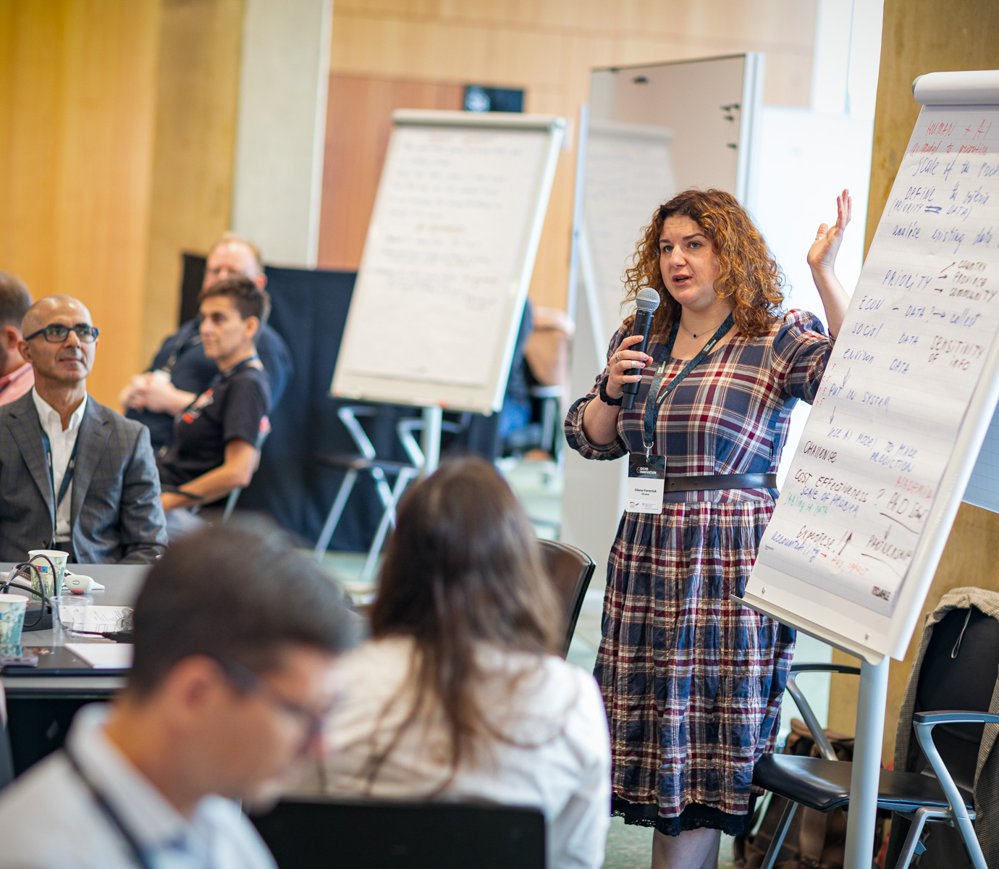
VALUES OF THE INNOVATION HUB
1
2
Needs-based
+65% open discussions
Networked Collaboration
Operators, national authorities, industry, R&T, academia
3
4
Inclusiveness
23 countries 27% women
Beyond Tech
Ethics/Human Rights approach to AI
© GICHD/Antoine Tardy
Notes:
Mapping against the values of the Innovation Hub.

Slide 4


ARTIFICIAL INTELLIGENCE – WHAT IS IT?
A computational technology that enables digital systems to perform tasks typically requiring some level of human intelligence
Mimic of an intelligent response
© greglobinski/CreativeCommons
© Pug Girl/ CreativeCommons
Notes:
Tasks such as understanding language, assisting the prodution of written records, recognizing images, analysing data, or generating decision-making options for complex problems. AI will do these things so well that the results will seem almost human-like in their accuracy.
Mention limitation of understanding causal inference – it’s a highly capable statistic problem solver.
If this is important to understand from the first place, it must be acknowledged this in no small feature and that the opportunities that can be unlocked is immense.
"tulips" by greglobinski is licensed under CC BY 2.0.
"Tulip fields around Keukenhof" by Pug Girl is licensed under CC BY 2.0.

Slide 5
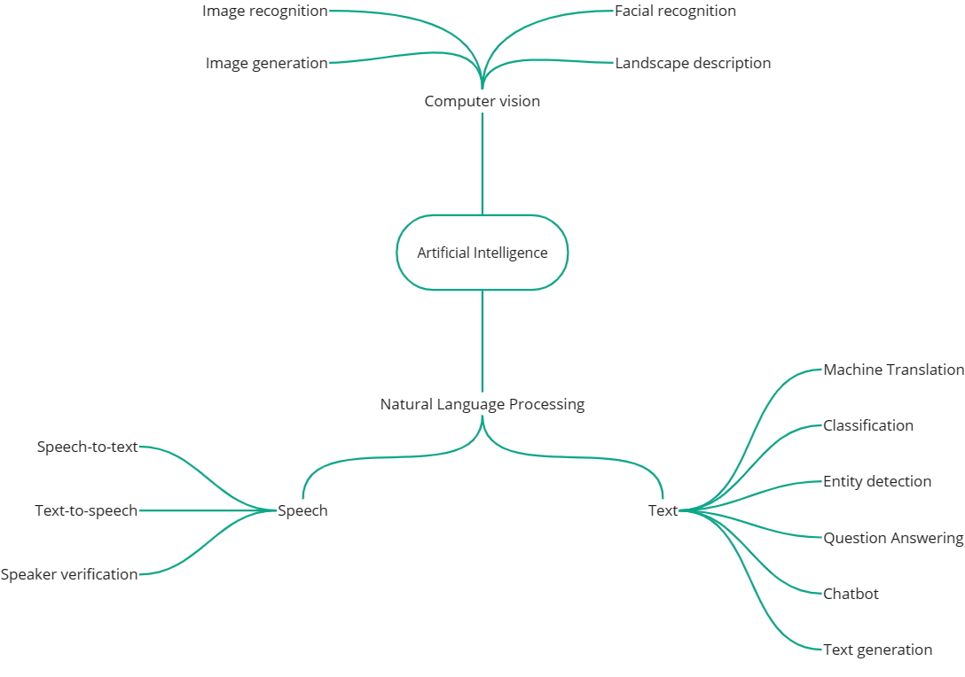
ARTIFICIAL INTELLIGENCE – WHAT IS IT?
Data (structured and unstructured)
Cloud computing (storage and processing power)
Algorithms (code)
  Generic
  Customized
Unique adaptability to specific contexts
Notes:
Example of the artificial tulip – can excel in specific features.

Slide 6

AI&ETHICS - RESPONSIBLE DEVELOPMENT
Enhancing human decision (NOT replacing)
Human oversight
Transparency and explainability
Managing risk
Useful references:
Montreal Declaration for Responsible AI (2018)
EU AI Act (2024)
UN General Assembly Resolution A/78/L.49 (2024)
Notes:
With great opportunities come great risks.
Enhancing human decision is more than having a human in the loop – is designing from scratch technological solutions that allow the end user to do his work safely and more efficiently.

Slide 7

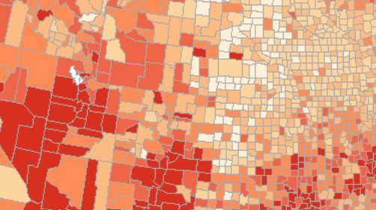
THE OUTPUTS
Most actionable, groundbreaking and impactful
Thematic project briefs
Global 3D EO reference database for automated image recognition of explosive ordnance
Identification of contaminated areas for early impact analysis
EO
Socio-economic
Environmental
Advanced data analytics and interrogation of IM systems
Improving organizational processes (GenAI)
Community engagement and EORE
IM systems, data integration & priority setting
Robotics and autonomous mechanical systems
Satellite imagery processing and analysis
UAV-deployed sensor data fusion and analysis
More info at GICHD Webpage: Innovation Session AI for Mine Action
Notes:
How? The outline

Slide 8



GLOBAL 3D EO Reference DATABASE
Collaborative Global 3D Reference Database of EO for Imagery Recognition
Sat imagery analysis, open source, survey, detection
Safety, rubble/debris removal
Asset protection, robotics
AI computational methods
Collection of visual data
Use cases
Resource intensive model creation
Access to EO items
+5000 different EO
Notes:
How?

Slide 9

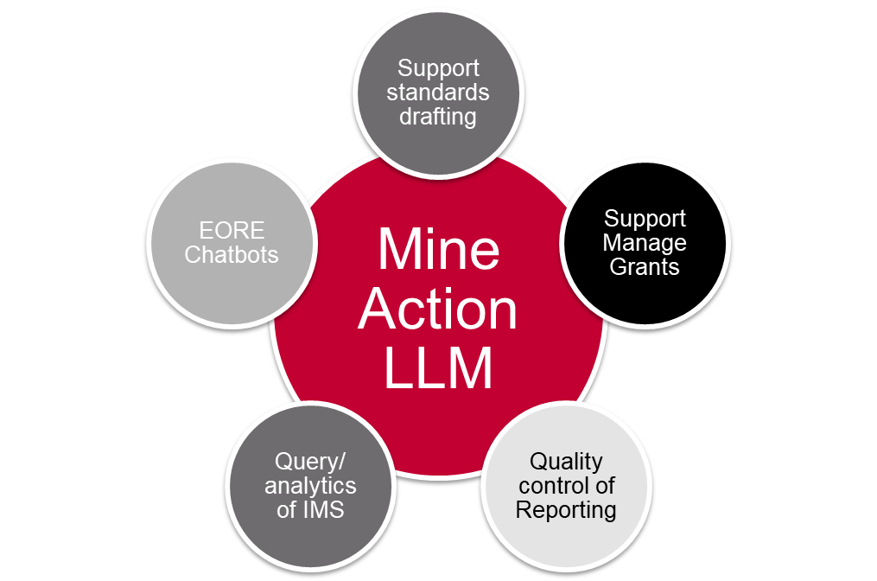
MINE ACTION Customized LLM
LLM - Large Language Model
Mine Action LLM
Support standards drafting
Support Manage Grants
Quality control of Reporting
Query/ analytics of IMS
EORE Chatbots
Customized and fine-tuned with mine action relevant data sources
Recognition and interpretation of mine action terminology
Context-aware and multilingual
Notes:
These projects propose a tailored LLM to accurately interpret mine action standards terminologies, reducing misunderstandings in documents and communications.

Slide 10
UPDATES
Croatia Mine Action Symposium 2025
03 APR 2025

Slide 11





THE CHALLENGES FOR INNOVATION IN EORR
Funding gaps
Silver bullet
Reinventing
Cost-effectiveness and Limited Funding: cost-efficiency of innovation; dedicated funding is imperative to bolster innovation.
Testing and Evaluation
programmatic setup
"Silver Bullet"/Predilection for Universal Solutions: one-size-fits-all solution;
oversight of specific contextual needs; suboptimal outcomes; low added value.
Finance
Ego
Time & funding
Scaling
Bureaucracy
Fear
Lack of coordination
Red Tape
Time
Risk assessments
Wars
Inadequate Collaboration and Coordination: redundant efforts; fragmented strategies; inefficient allocation of resources.
Funding
Security
Mis-communication
Lack of a Uniform Legal and Regulatory Framework: striking the right balance between national regulations, technical standards, operational procedures and innovation.
Dogma
Viability
Standards
Sponsors
Shifting behaviour
Fear of change
Data
Resistance to Change: risk avoidance of trying and failing; curtails progress.
Resistance to change
Evidence
Too slow
Notes:
As was noted and as we witness almost daily, innovation already emerges within the field of mine action and ammunition management, regardless of the present conceptual considerations. However, we also witness considerable challenges to “successful” innovation. During the 2023 GICHD Innovation Conference some of these challenges have been described and highlighted: silver bullet bias, insufficient needs-based approaches, lacking collaboration and common legal/regulatory basis, reduced cost-effectiveness and limited funding and resistance to change. It is unsurprising to find a very strong co-relation between these and those identified in other Humanitarian Innovation systems.

Slide 12

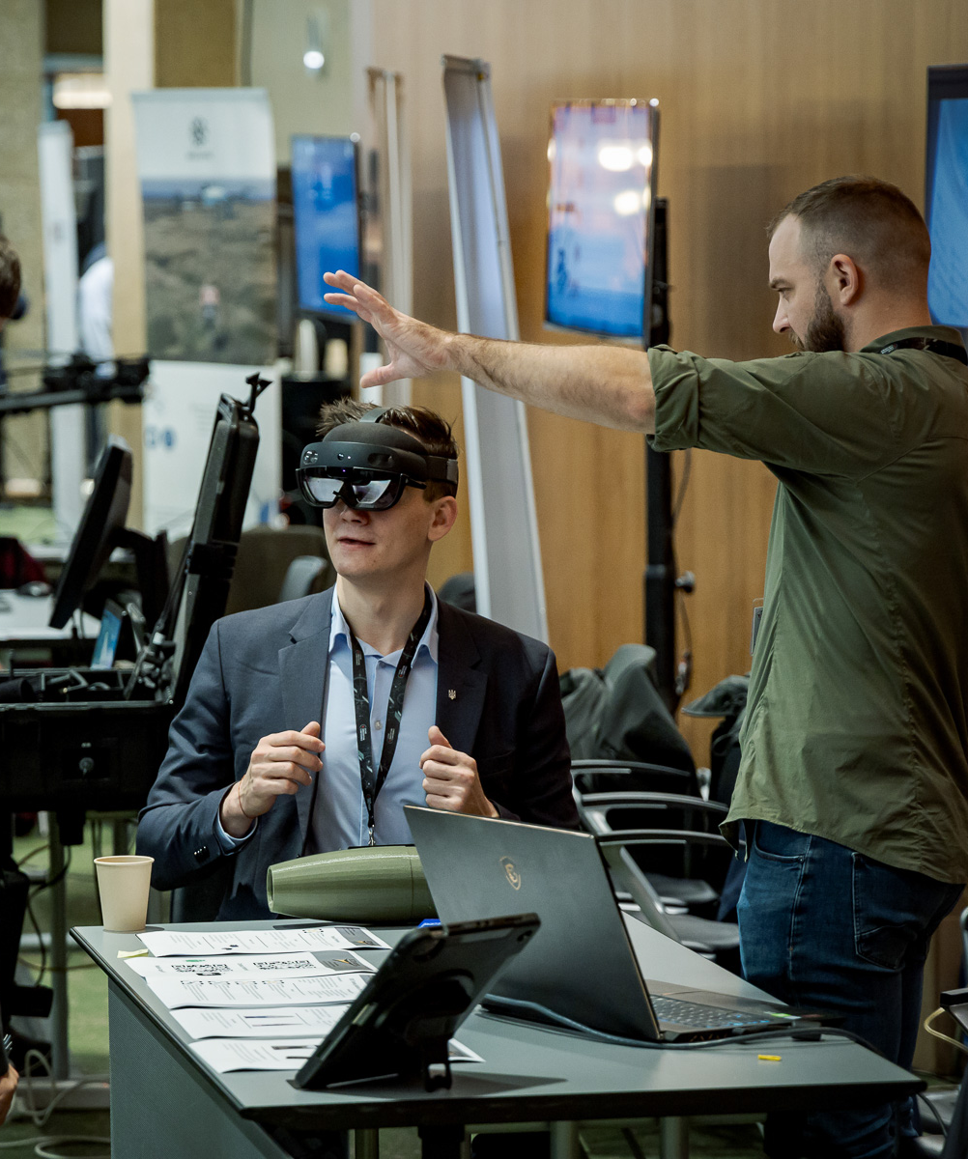
What is innovation?
Innovation is the creation or adoption of a new or improved product ,
or process which is novel to MA, addresses evidence-based ,,
problems, and contributes to safer, more efficient, and more effective management of the threats posed
by explosive ordnance.
It may take various forms, including a policy, a methodology, a process, or a product (technological or other).
Notes:
Pedro.
Straight out of the ISO, to generically frame what innovation is.

Slide 13
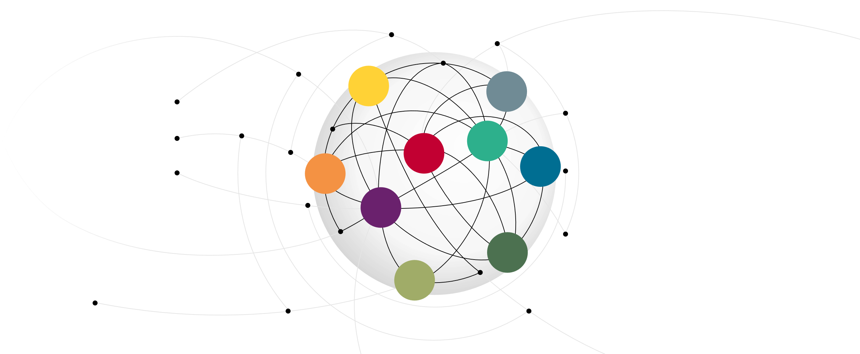


















EORR INNOVATION SYSTEM
Intellectual Property
Academia
EO affected communities
Funding mechanisms
National & local authorities
Mine Action Organisations
Equipment Manufacturers
Research & Technology Orgs.
Standards & Regulations
Notes:
Pedro.
Evidence shows that the emergence of Innovation can be better understood as an outcome of an Innovation System.
Comprised of numerous building blocks requiring constant interaction to find suitable collaboration mechanisms and enable relevant outcomes
System approach & mapping of building blocks → serves as framework of analysis & facilitates identification and treatment of gaps and/or bottlenecks
Descibe briefly some of the features of an innovation system. Open, dynamic and adaptative. Provide a couple of examples of the dynamics in MA and or AM.
Refer to the shortcomings mentioned in slide 3 to link to what a possible fix – an Innovation Hub.

Slide 14
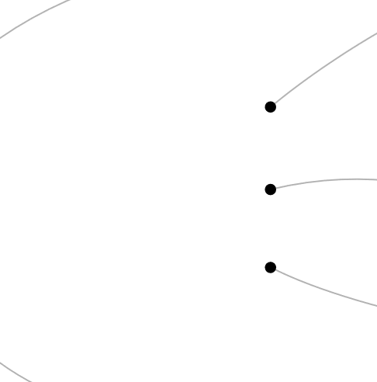




ENABLING EORR INNOVATION SYSTEM
INNOVATION HUB
Research Activities
Technical
Advisory Group(s)
Innovation Activities
Steering Committee
Research Agenda(s)
Test & Evaluation
Aims to convene stakeholders, generate and disseminate knowledge, promote needs-based innovation, and facilitate collaborative steering of innovation efforts.
Notes:
Shape resembles an enzyme, proteins that help speed up metabolism, or the chemical reactions in our bodies.
Innovation hub should have a similar effect on the Innovation System. It’s three main lines of activity are multishaped, as they need to find the right fit to the varied stakeholders/connections in the system, requiring support. No single solutions fits all. Innovation Hubs are also known as Innovation accelerators, incubators, boosters, forums, etc.
Explain what it each component does, using next slide and return to use the scheme to explain in more detail how the elements can address the shortcomings of slide 3.

Slide 15







EORR INNOVATION HUB
Steering
Committee (SC)
Multi-stakeholder
body comprising high level representatives
Provides overall strategic direction within the sector with regards to needs-based research and innovation
Technical Advisory
Group (TAG)
Operational arm of the
Innovation Hub
Identify, discuss, and analyze cutting-edge technologies, products and processes
that can be explored
Inform the SC on possible avenues of approach to address priorities
Guiding Principles
Evidence-based
Networked collaboration
Inclusiveness
Beyond technologies
Notes:
Place focus on the TAG and the Guiding Principles.
Over to Armen…

Slide 16
EORR INNOVATION SYSTEM
Dynamic and emergent process
Intellectual Property
Standards & Regulations
EO affected communities
Mine Action Organisations
Multiple Actors
Academia
National &
local authorities
Funding mechanisms
Respective Relationships
Equipment Manufacturers
Research & Technology Orgs.
Notes:
Pedro.
Evidence shows that the emergence of Innovation can be better understood as an outcome of an Innovation System.
Comprised of numerous building blocks requiring constant interaction to find suitable collaboration mechanisms and enable relevant outcomes
System approach & mapping of building blocks → serves as framework of analysis & facilitates identification and treatment of gaps and/or bottlenecks
Descibe briefly some of the features of an innovation system. Open, dynamic and adaptative. Provide a couple of examples of the dynamics in MA and or AM.
Refer to the shortcomings mentioned in slide 3 to link to what a possible fix – an Innovation Hub.

Slide 17




Guiding Principles
Evidence-based approach
Focuses on relevance
and impact
Engages with difficult questions
Actively listens to stakeholders
Genuinely understands stakeholder’s needs and context
Efforts are directly aligned with real-world requirements
Networked collaboration
Focuses on quality, quantity, and stability of its connections
Strengthens ties between national EORR initiatives and international organizations
Facilitates knowledge sharing, encourages specialization within the network, and reduces overlapping efforts
Inclusiveness
Focuses on diverse perspectives and expertise
Creates opportunities for knowledge exchange and collaboration across disciplines
Broader access to innovation and expertise by extending activities to local organizations
Beyond technology
Focuses on the development and adaptation of methodologies and standards
Provides alternative solutions to complex problems
New methodologies may lead to groundbreaking innovations
Supports a holistic view of innovation
Notes:
Evidence-based Approach:
The true value of innovation lies in its relevance and impact on the specific needs of EORR. Success hinges on the willingness to engage with difficult questions, actively listen to stakeholders, and genuinely understand their needs and context. This approach ensures research and technology efforts are directly aligned with real-world requirements, guiding problem-solving in a focused and effective manner.
——
Networked Collaboration:
The strength of an innovation system is measured by the quality, quantity, and stability of its connections. Enhancing the network involves strengthening ties between national EORR initiatives and international organizations, as well as linking with other innovation platforms. This global and regional cooperation facilitates knowledge sharing, encourages specialization within the network, and reduces overlapping efforts. Moreover, learning from sectors that have successfully implemented innovative solutions enriches the system with proven methodologies and technologies.
——
Inclusiveness:
Innovation thrives in environments that welcome diverse perspectives and expertise. By organizing open forums with varied representation, the Hub creates opportunities for knowledge exchange and collaboration across disciplines. Extending activities beyond Geneva through local organizations ensures broader access to innovations and expertise, making them more available to different regional contexts.
——
Beyond Technology:
While technological advances are crucial drivers of innovation, they are not standalone solutions to complex problems. The development and adaptation of methodologies and standards are equally important and must proceed in tandem with technological advances. In some cases, new methodologies themselves may represent groundbreaking innovations. The EORR Innovation Hub is dedicated to supporting a holistic view of innovation, recognizing the importance of both technology and methodology in solving real-world challenges.

Slide 18


GICHD INNOVATION IN 2025
Call for papers: Risk management in mine action
  Improving the accuracy of estimating EO hazardous areas
  Quantifying residual risk in land release
Deadline for abstracts: 11Apr25
Info at: Innovation Award Webpage
Register and contribute to shape Agenda: Innovation Conference 2025 – Application Form
Info at: Innovation Conference 2025 Webpage
Notes:
Rationale: The GICHD Innovation Award is designed to promote, recognize and honor creative solutions to continually improve efficiency, effectiveness and safety in EO risk reduction. By connecting innovative thinking with real-world applications, it fosters a culture of innovation and drives measurable improvements in the field.
Target Audience: The Award is open to individuals, organizations, and consortiums that bring diverse perspectives and expertise from a variety of sectors such as academia/scientific community, technology providers, entrepreneurs, National Mine Action Authorities and mine action organizations. The participants are incentivized to partner with National Mine Action Authorities (NMAA), mine action field practitioners and organizations
Thematic focus: The thematic focus of the GICHD Innovation Award 2025 will be risk management in mine action. Award participants are required to addresses one of the two pre-defined problem statements:
Topic 1: Improving the accuracy of estimating explosive ordnance hazardous areas
Topic 2: Quantifying residual risk in land release
Call for papers: The Award takes the form of a Call for Papers. Participants are invited submit written abstracts. After the evolution of submitted abstract. Shortlisted participants are invited to submit a full paper. The call for papers outlines in detail the problem statement topics, submission guidelines, deadlines, and evaluation criteria.
Evaluation: Participants are encouraged to address the problem statements through a creative and practical approaches. The abstracts and full papers are evaluated by the Award Panel (from academia/scientific community, mine action stakeholders, GICHD and mine action donor) on four criteria:
• Innovation;
• Feasibility;
• Scalability; and
• Impact.
Incentives and recognition: Awardees(s) will be invited (and sponsored) to present their submission at the GICHD Innovation Conference 2025 in Luxembourg, 27 – 30 October 2025. A financial reward of CHF 4000 will be given to one awardee per problem statement
Detailed information: Detailed information about the call for papers, problem statements and submission/evaluation process can be found on the dedicated GICHD Innovation Award Webpage: https://www.gichd.org/publications-resources/innovation-in-the-gichd/gichd-innovation-award-2025/

Slide 19

Thank you!

